Slide 1

University Management System
A Mini Project for Database Management System 2025
THAPAR INSTITUTE OF ENGINEERING AND TECHNOLOGY
Supervised by Dr. Shashank Singh

Slide 2




Introduction & The Problem
Complex Data Management
Manual Systems
Traditional methods inefficient, error-prone
Universities manage vast, complex data
Need for Automation
Centralized system required for modern institutions

Slide 3








Our Objectives
Enhanced Security
Role-based access
Process Automation
Registration, enrollment, exams, fees
Centralized Database
Student, faculty, course, exam data
Minimize Errors & Redundancy
Structured DB schema

Slide 4


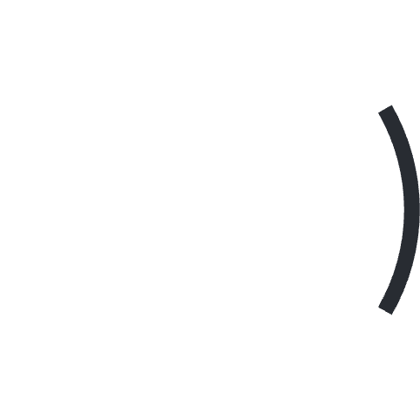









Functional Scope
Student Management
Faculty Management
Registration, profiles, enrollment
Profiles, course responsibilities
Department Management
Course Management
CRUD by Admin, HOD Appointment, Faculty Association
CRUD operations by admin
Fee Management
Examination
Generation, payment simulation
Scheduling, results storage

Slide 5
Technical Scope & Limitations
Technical Stack
Out of Scope
Flask (Python) backend
Attendance tracking
MySQL database (Aiven)
Hostel management
HTML/CSS/JS frontend
Library integration
Render cloud deployment
Real payment gateway

Slide 6
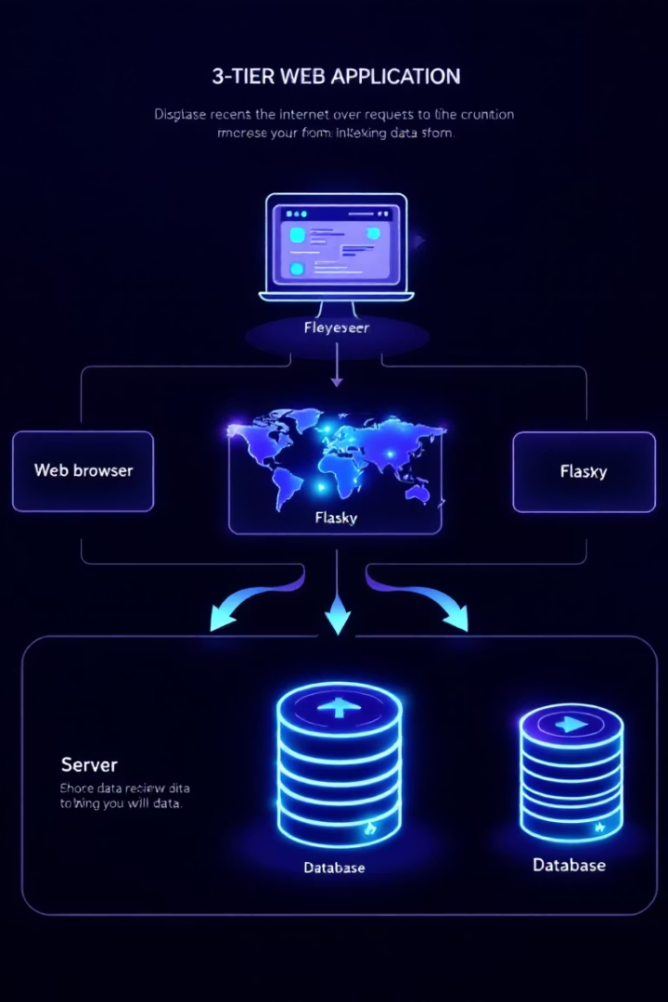



System Architecture (3-Tier)
Presentation Tier
Web browsers, HTML/CSS/JS, Jinja2
Application Tier
Flask app, business logic, session management
Data Tier
MySQL database, persistent storage

Slide 7
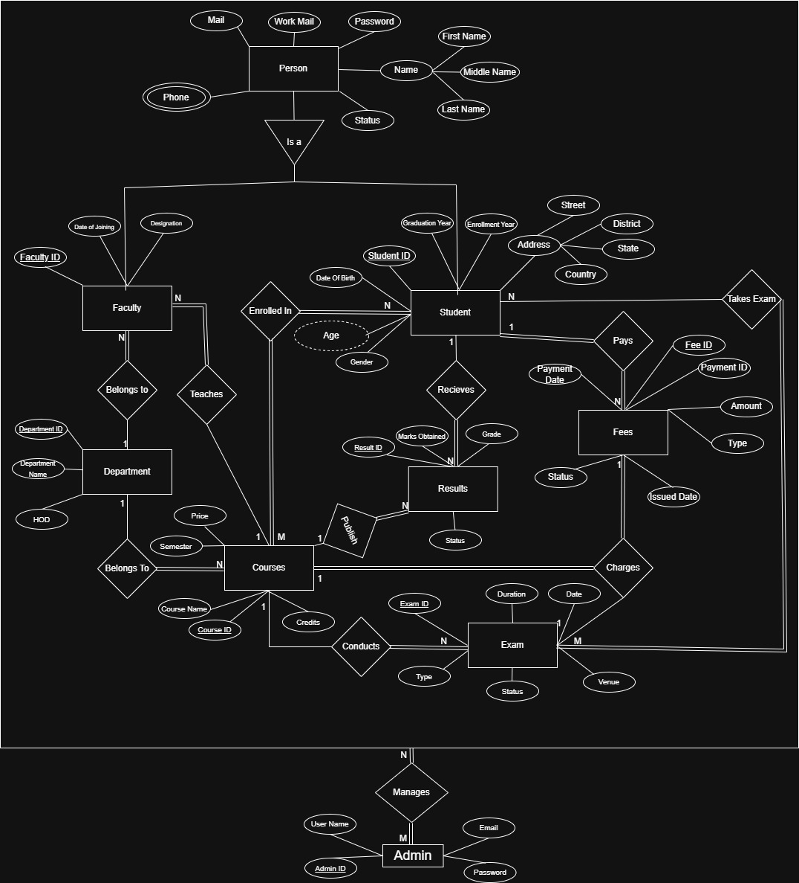
Database Design - Conceptual Model
Entity-Relationship model showing core entities and relationships
Core Entities
Key Relationships
Person, Student, Faculty, Admin, Course
Enrollment, Teaching, Takes Exam
Supporting Entities
Fees, Results, Department

Slide 8
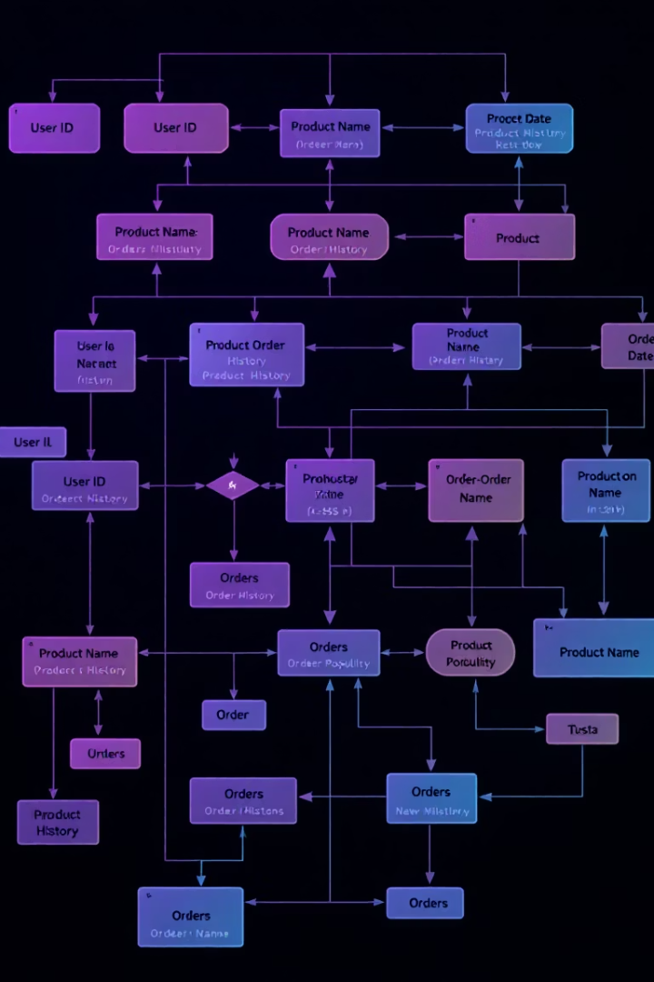
Relational Schema & Relationships
Core Tables
Students, Faculty, Courses, Departments
Junction Tables
Enrollment (N:M), Takes_Exam (N:M)
Dependent Tables
Fees, Exams, Results with FKs

Slide 9




Key Implementation Aspects
main.py
Flask app, routes, business logic
2
database_prerequisite.py
Table creation, initial data
User Interface
HTML/CSS/JS with Jinja2 templates
Automated Features
Credential generation, email notifications

Slide 10





Testing Approach
Access Control
Core Workflows
Data Validation
Notifications
Role-based permissions
Registration to results
Form inputs, integrity
Email delivery verification

Slide 11

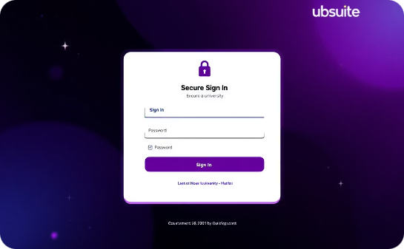
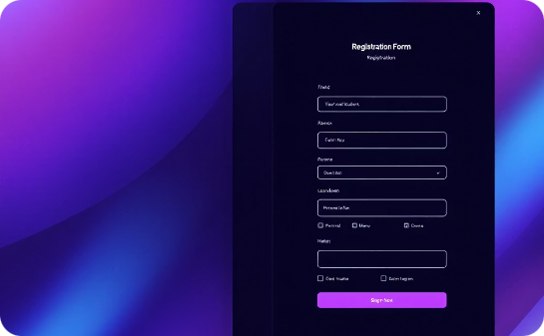
Results - Live Application
Our university management system is fully functional and deployed, available at:
https://university-management-system-uauc.onrender.com/
Landing Page
Sign In Page
Registration Page
Clean, intuitive interface welcomes users to the system with clear navigation options.
Role-based authentication system requires official email credentials for secure access.
Separate forms for student and faculty with role-specific data fields.

Slide 12
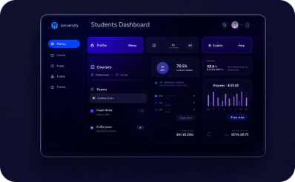
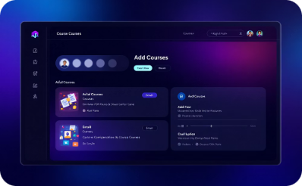
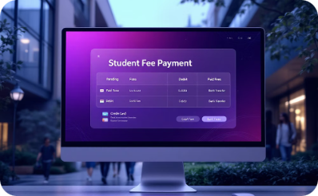
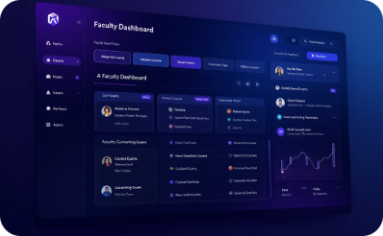
Results - User Dashboards & Features
Student Dashboard
Course Registration
Fees Management
Faculty Dashboard
Personalized view with quick access to profile, exams, results, and fee information.
Intuitive interface for browsing and enrolling in available courses.
Easy tracking of payment history with simulated payment processing.
Dedicated portal for instructors to manage courses and view examination schedules.

Slide 13
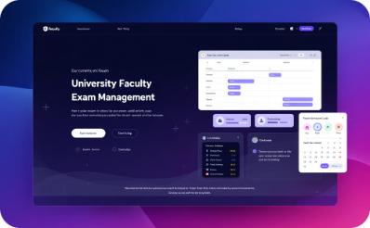
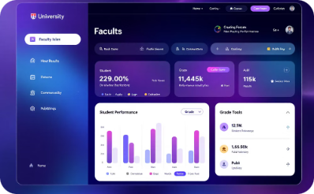
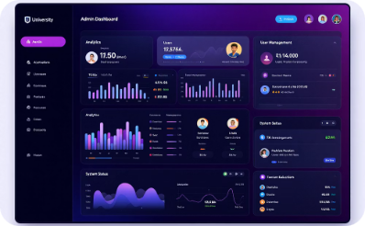
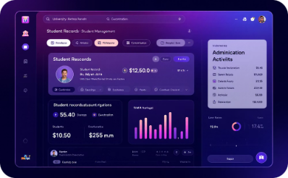
Results - Admin Management
Faculty Exam Management
Faculty Result Evaluation
Admin Dashboard
Admin Control Center
Centralized control panel gives administrators complete oversight of all system operations and key performance indicators.
Powerful tools for managing student records, course structures, and departmental organization across the entire university system.
Intuitive interface allows faculty to schedule exams, set parameters, and manage the entire examination process seamlessly.
Comprehensive tools for faculty to evaluate student performance, assign grades, and publish results with just a few clicks.

Slide 14




Conclusion
Project Success
Process Automation
Role-Based Design
Future Growth
Delivered comprehensive UMS for Thapar Institute's academic needs.
Streamlined registration, enrollment, exams, fees, and results management.
Tailored interfaces for students, faculty, and administrators.
Established solid foundation for system expansion and enhancement.
Our UMS demonstrates practical application of database principles and full-stack development, significantly reducing manual workload across university operations.

Slide 15
Future Work & Enhancements
Academic Modules: Develop attendance tracking, library management, and hostel administration modules to expand system capabilities
Infrastructure Improvements: Implement real payment gateways, advanced reporting, and robust timetable scheduling
Technical Refinements: Enhance security through password hashing and input sanitization while optimizing performance
Integration & Testing: Create APIs for mobile applications and implement comprehensive automated testing frameworks
User Experience: Polish UI/UX design for intuitive navigation and responsive interfaces across all devices

Slide 16
Acknowledgements
Department of CSE, TIET
Dr. Shashank Singh
For providing the opportunity, exceptional guidance, and state-of-the-art infrastructure needed to develop our University Management System.
Our faculty supervisor whose encouragement, constructive feedback, and technical assistance were invaluable throughout the project journey.
Online Community
Families and Friends
The countless developers, authors, and contributors whose shared knowledge and resources helped us overcome technical challenges.
For their unwavering support, understanding, and patience during late nights and busy weekends of development.
Thank you to everyone who contributed to making this University Management System a reality!

Slide 17

Questions?
We welcome your thoughts and inquiries about our University Management System implementation. This is your opportunity to explore the technical details, functionality, or future enhancements.

Slide 18

Thank You
We appreciate your time and attention to our University Management System presentation. Your feedback will help us continue improving and expanding this solution.

